Slide 1
Get To Know BCGW
How the Business Centre Guelph-Wellington can help you start and further your business!

Slide 2
Partners

Slide 3
Mandate
To build and support entrepreneurs
To provide the entry point for entrepreneurship in Guelph and Wellington County, helping individuals get into business for themselves
To support the growth strategies of existing small businesses in our region so that they are both relevant and competitive in the marketplace

Slide 4
Who we represent
65% of funding comes from Ministry of Economic Development, Job Creation and Trade (Provincial)
30% From City of Guelph, County of Wellington and Centre Wellington
5% comes from new fee for service offerings 1 of 47 Small Business Centres across Ontario
Founding Board member of SBC Ontario
Representation on Boards of Trade, BIA’s, County of Wellington Committee, CW Economic Development Task Force, Grow Guelph, Smart Cities business stream and Regional Innovation Centre Committees

Slide 5
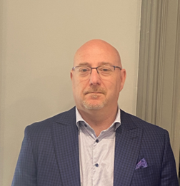
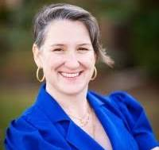
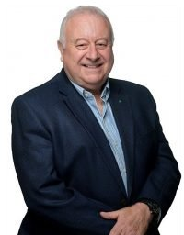
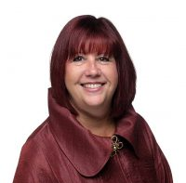
Our Team

Slide 6
Consultations
Each confidential consultation is specific to the business needs
We offer a range of expertise including, human resources, marketing, accounting, succession planning and growth strategies
Our advisors will often recommend what clients can do next to best move forward
Based on the consultation, they may be eligible to participate within one of our grant programs (Triage)

Slide 7
Start Up Programs
Business 101
Stepping Into Business
2-hour monthly workshop
An informational session for getting started in business
Introduction to a business model canvas
Overview of required items prior to starting a business
6-week program
Completed business model canvas
Completed user persona and customer journey map
Completed financial projections

Slide 8
Existing/Growth Programs Starter Company +
A customized implementation plan to solve challenges in your business
Access to the "Ask the Professionals" networking event
1-on-1 business mentoring specific to your business/industry
Group learning/networking opportunities with other participants
Interact with a supportive network of other like-minded business owners
Participants successful in completing the program will be awarded up to $5000 in grant monies

Slide 9
Summer Company
An award of up to $3,000
A first payment of up to $1,500 for start-up costs
A second payment of up to $1,500 once they have successfully completed the program
Hands-on coaching
Mentoring from business leaders in your community and from your program provider

Slide 10
New Offerings
We are regularly updating and increasing our offerings for all business types.
Check out our monthly programming page to see upcoming topics and workshops.
https://www.guelphbusiness.com/events/
https://www.guelphbusiness.com/programs/

Slide 12
Contact Us
Phone
Tel: 519-822-1260 Ext 3907
Email
success@guelphbusiness.com
Website
www.guelphbusiness.com
Social Media
@bcguelphwell
/bcguelphwell
@BCGuelphWell
/BCGuelphWellington

